Slide 1



UNIVERSITY INSTITUTE OF ENGINEERING
COMPUTER SCIENCE ENGINEERING
Bachelor of Engineering
Cloud Computing(CST-411)
Prepared By: Ms. Himanshu(E11818)
Topic: Features of Cloud Computing
Architecture
DISCOVER . LEARN . EMPOWER

Slide 2
Learning Objectives & Outcomes
Objective:
To understand the Architecture of Cloud Computing
Outcome:
Student will understand
Features of Cloud Computing
Architecture of Cloud Computing

Slide 3
Overview
Architecture of Cloud Computing
Components of Cloud Computing Architecture
Features of Cloud Computing Architecture

Slide 4

Cloud Computing Architecture

Slide 5
Cloud Computing Architecture
The Cloud Computing Architecture of a cloud solution is the structure of the system, which comprise on-premise and cloud resources, services, middleware, and software components, geo-location, the externally visible properties of those, and the relationships between them.
The term also refers to documentation of a system's cloud computing architecture.

Slide 6
Contd…
Cloud Computing architecture comprises of many cloud components, which are loosely coupled. We can broadly divide the cloud architecture into two parts:
Front End
Back End
Each of the ends is connected through a network, usually Internet. The following diagram shows the graphical view of cloud computing architecture:

Slide 7
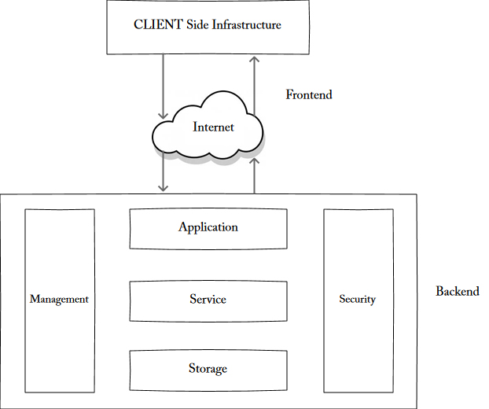

Slide 8
Components of Cloud Computing Architecture
Hypervisor
Management Software
Deployment Software
Route of Connectivity
A server of the Cloud
Storage of the Cloud

Slide 9
Hypervisor
The hypervisor is also known as Virtual Machine Monitor.
This consists of the software, hardware, and firmware which makes and runs the virtual machines.
The Hypervisor provides a user with a platform which is known as Virtual Operating Platform.
This allows us to manage the guest’s operating system to use the cloud.
This can be also known as the traditional term of the kernel in an operating system.

Slide 10
Management Software
Management software consists of various plans and the strategies which help to increase the performance of the cloud.
This management software provides many features such as on-time delivery of storage, proper security, all-time access, and many other facilities.
This is one of the important parts of Cloud Computing architecture.
One of the important features of this is the compliance auditing, management of overseeing disaster, and contingency plans.

Slide 11
Deployment Software
Cloud deployment simply means to initiate the working of the SaaS, PaaS, and IaaS.
This initiates the solutions that can access by the users or the customers.
This deployment consists of all the mandatory installations and configurations of the cloud.
This emerges from the back end and implements before the provisioning occurs.

Slide 12
Route of Connectivity
It is an important part of the Cloud Computing architecture, through which the whole cloud gets connected.
The speed of transfer depends on the network which is the internet connection.
There are many cloud servers present which connects with the help of this virtual route.
This also provides a facility to the user by allowing them to customize the route and protocol.

Slide 13
Cloud Server
A cloud server is a virtual server running in cloud computing premises. It’s engineered, hosted and delivered via a cloud computing platform via the web. It can be accessed from anywhere.
Cloud servers are stable, quick and secured.
They avoid the hardware problems seen with physical servers, and that they are seemingly to be the foremost stable choice for businesses. Also, called as virtual servers.

Slide 14
Storage of Cloud
Cloud storage service, construct to produce applications, services and organizations with access to offsite storage capability that may provision instantly are versatile in scaling automatically at runtime and is globally accessible.
Cloud Storage also benefits the user by providing remote access with the help of internet. The storage services are very quick to access.

Slide 15
Features of Cloud Computing
Following are the characteristics of Cloud Computing:
Resources Pooling
On-Demand Self-Service
Easy Maintenance
Large Network Access
Availability
Automatic System
Economical
Security
Pay as you go
Measured Service

Slide 16
References
Text books:
Buyya, Rajkumar, James Broberg, and Andrzej M. Goscinski, eds. Cloud computing: Principles and paradigms. Vol. 87. John Wiley & Sons, 2010.
Miller, Michael. Cloud computing: Web-based applications that change the way you work and collaborate online. Que publishing, 2008
Websites:
https://data-flair.training/blogs/cloud-computing-architecture/
https://data-flair.training/blogs/features-of-cloud-computing/
https://www.knowledgehut.com/blog/cloud-computing/cloud-computer-architecture

Slide 17
THANK YOU

